Slide 1

Phishing Email Detection Project
Team Members: Swikrit Aryal, Ashish Ghimire

Slide 2

Introduction
Phishing emails deceive users to compromise sensitive information. This project employs machine learning techniques to classify emails accurately as Safe or Phishing.

Slide 3

Objectives
1. Build a robust phishing email detection model.
2. Compare performance of multiple machine learning methods.
3. Apply hyper-parameter tuning to optimize results.
4. Handle class imbalance with advanced techniques.

Slide 4

Use-Case
Phishing detection helps organizations:
Prevent financial fraud and data theft.
Safeguard sensitive user information.
Improve email security for better user trust.

Slide 5

Description of Dataset
Dataset Overview:
- 18,000+ emails labeled as Safe or Phishing.
- Features: Email Text preprocessed into TF-IDF vectors.
- Class imbalance: 8,000 Safe vs. 10,000 Phishing emails.
Balancing was done using SMOTE (Synthetic Minority Oversampling Technique).

Slide 6

Methods Used
Models Evaluated:
1. Random Forest
2. Support Vector Machines (SVM)
3. Logistic Regression
4. Naive Bayes
Additional Techniques:
- TF-IDF for feature extraction.
- SMOTE for class balancing.

Slide 7
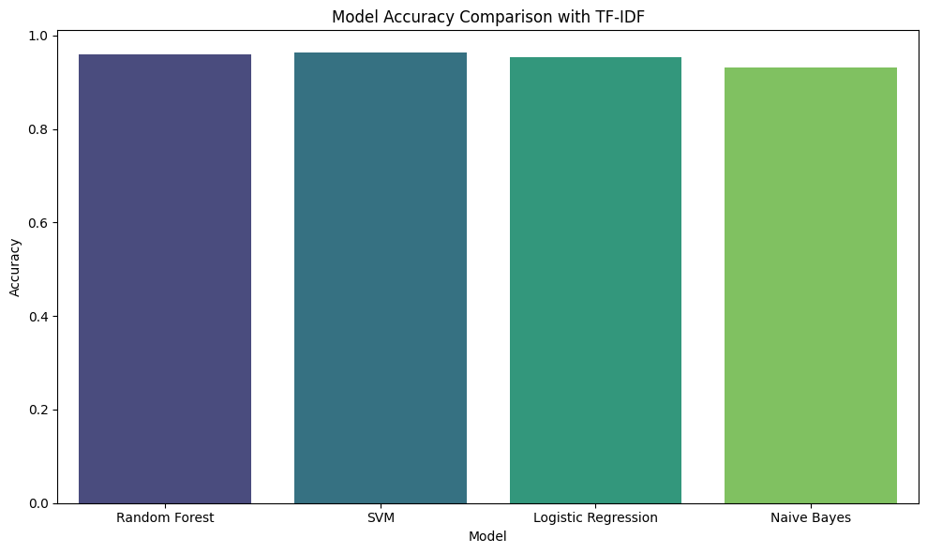
Results: Comparison of Methods

Slide 8
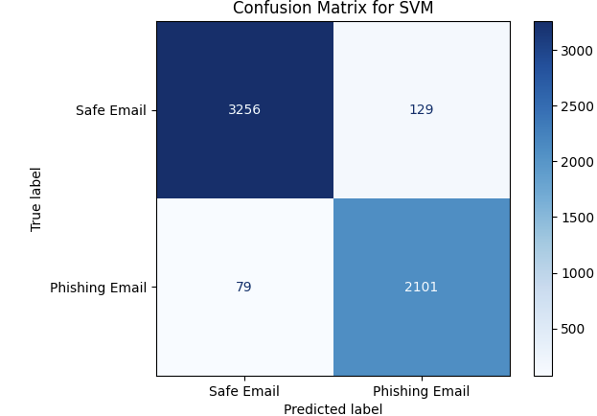
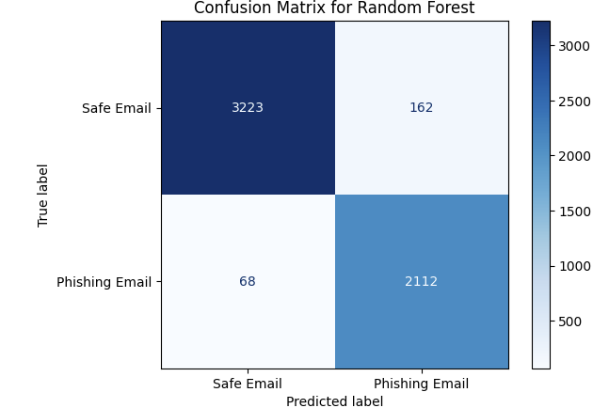
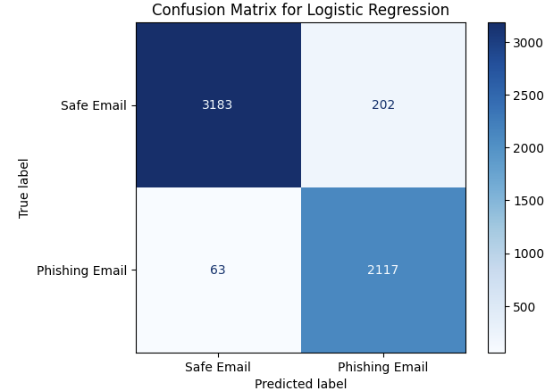
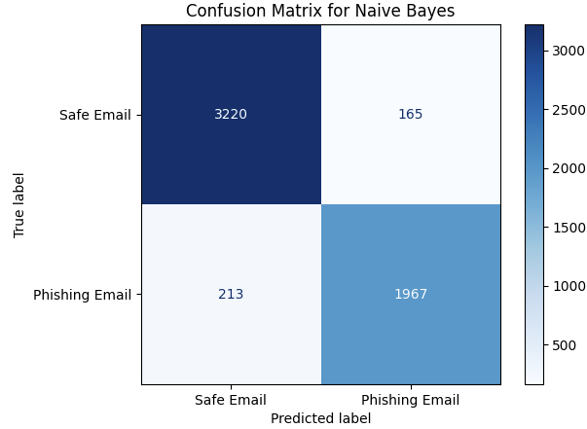
Confusion Matrices

Slide 9

Hyper-Parameter Tuning Results
SVM:
- Accuracy Improved to 96.5%
Random Forest:
-- Accuracy Improved to 94.2%
Logistic Regression
--Accuracy improve to 89.6%
Naïve Bayes
--Accuracy improved to 88.2%

Slide 10
Work Distribution
Swikrit Aryal:
- Data Preprocessing
- Hyper-Parameter Tuning
- Model Training
Ashish Ghimire:
- Feature Extraction
- Balancing Techniques
- Results Analysis and Visualization

Slide 11
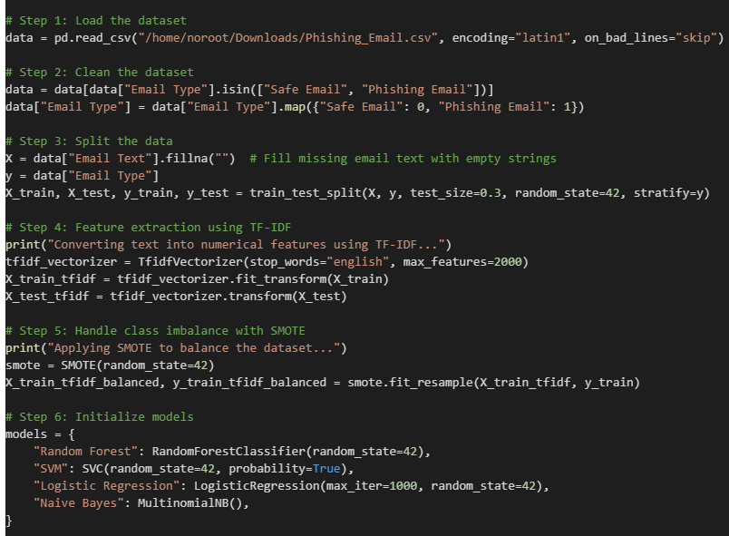
Our Code in steps:

Slide 12
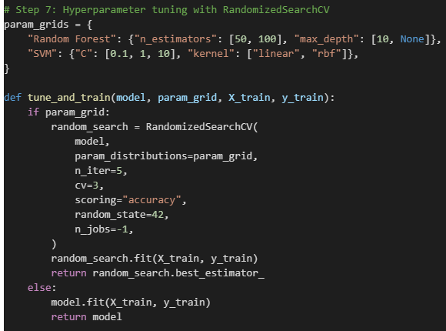
Hyperparameter Tuning

Slide 13
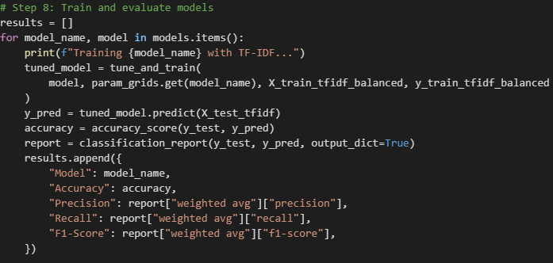
Training and Evaluation Part

Slide 14
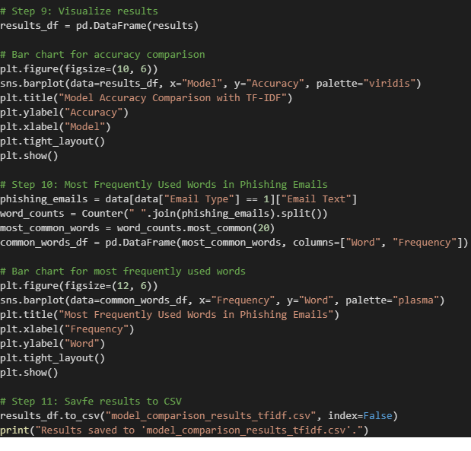
Cleaning Up:

